Slide 1
Zomato India Data Analysis Group - 9

Slide 2
Data Collection

Slide 3
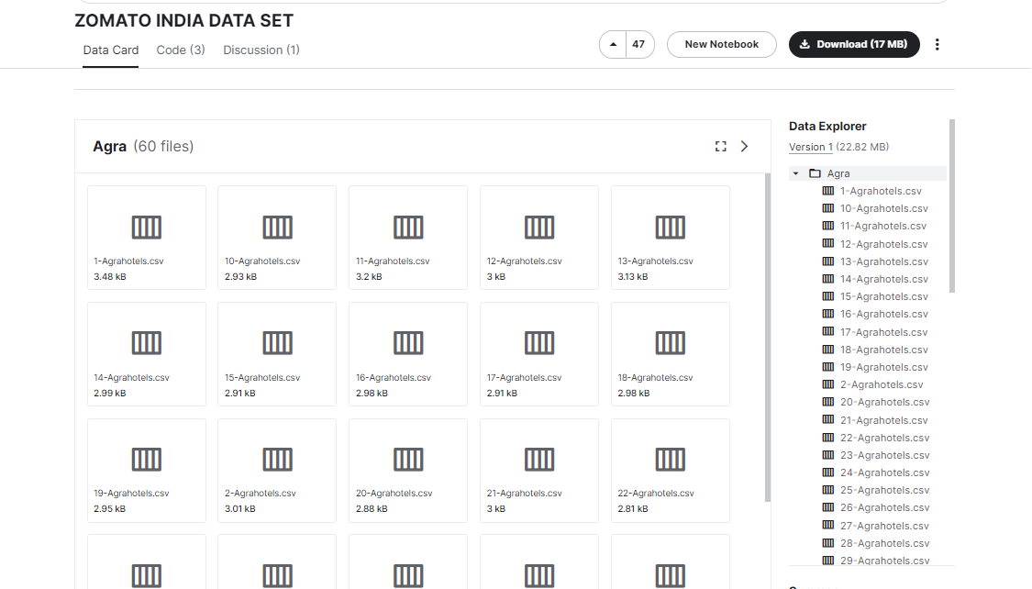
Data Collection

Slide 4
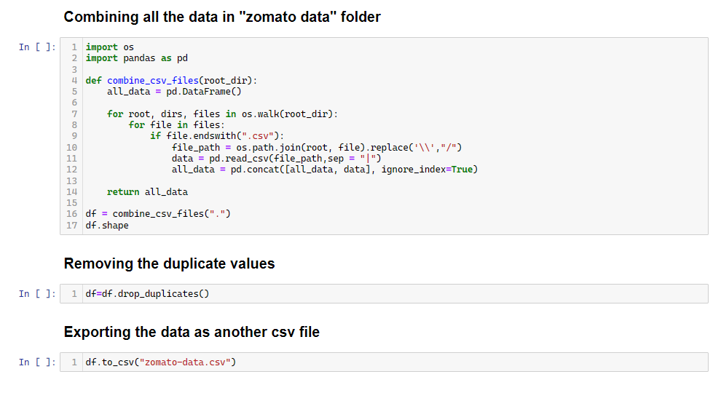
Data Collection

Slide 5
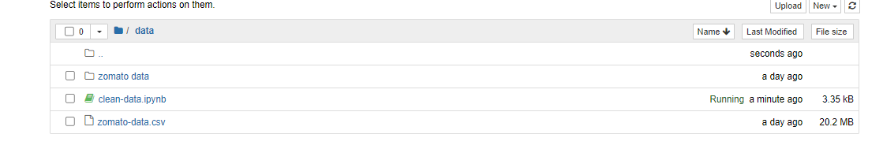
Data Collection

Slide 6
Data Cleaning

Slide 7
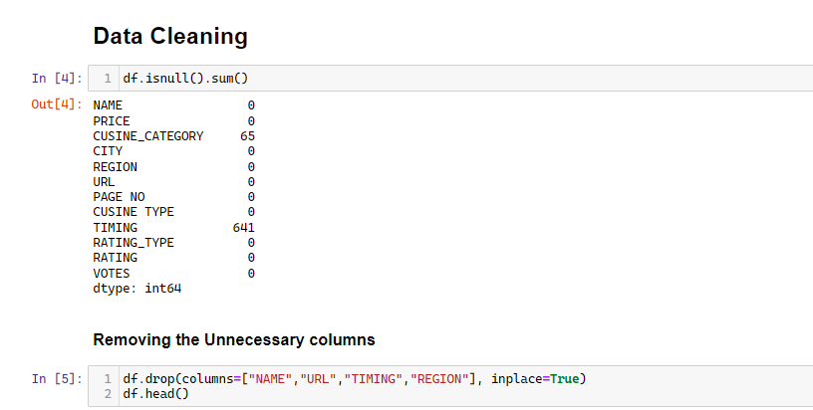
Data Cleaning

Slide 8
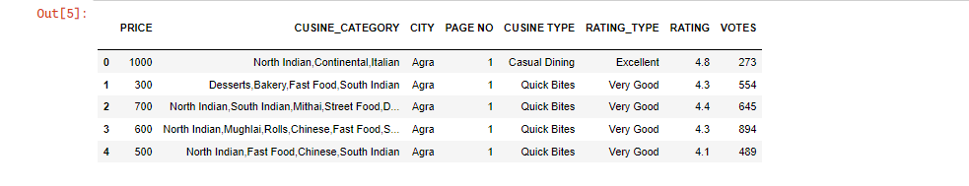
Data Cleaning

Slide 9
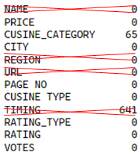
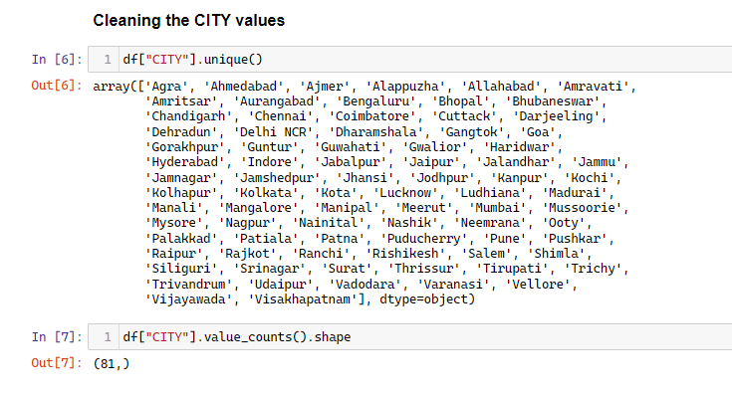
Data Cleaning

Slide 10
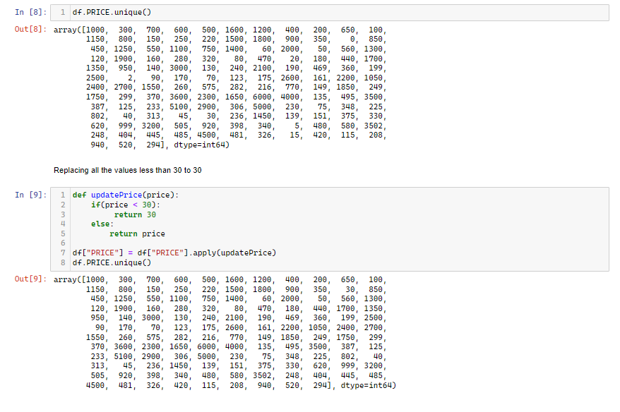
Data Cleaning

Slide 11
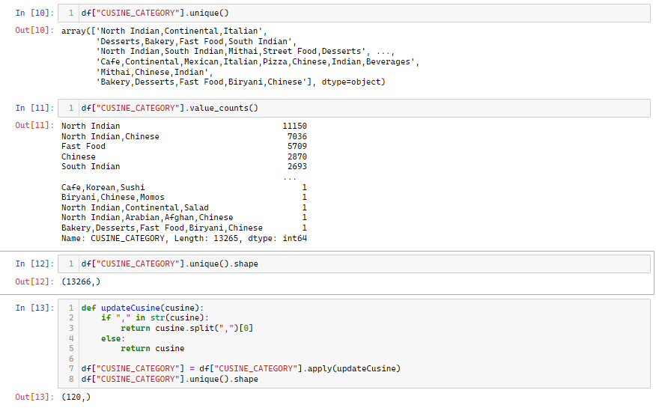
Data Cleaning

Slide 12
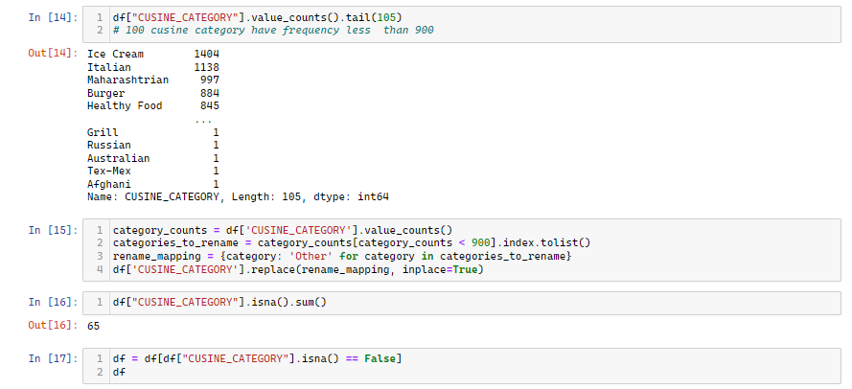
Data Cleaning

Slide 13
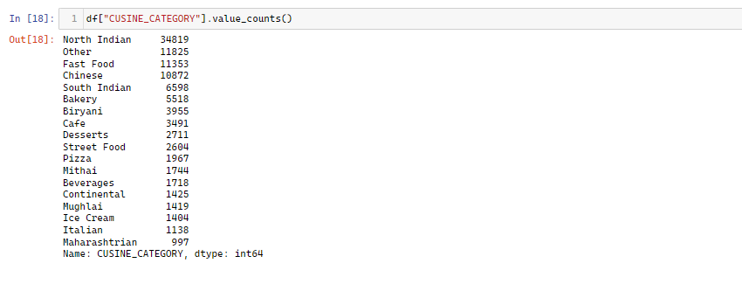
Data Cleaning

Slide 14
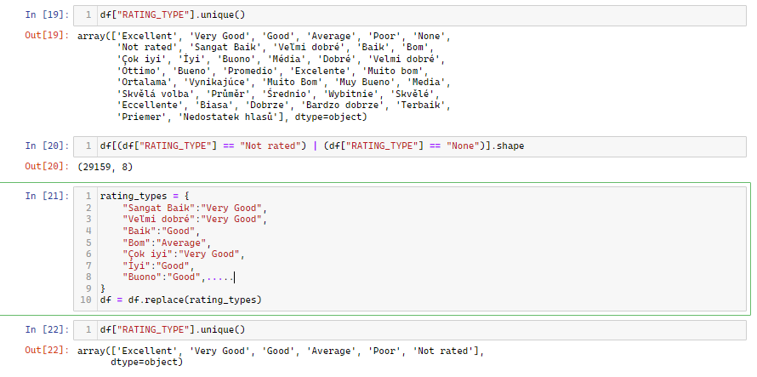
Data Cleaning

Slide 15
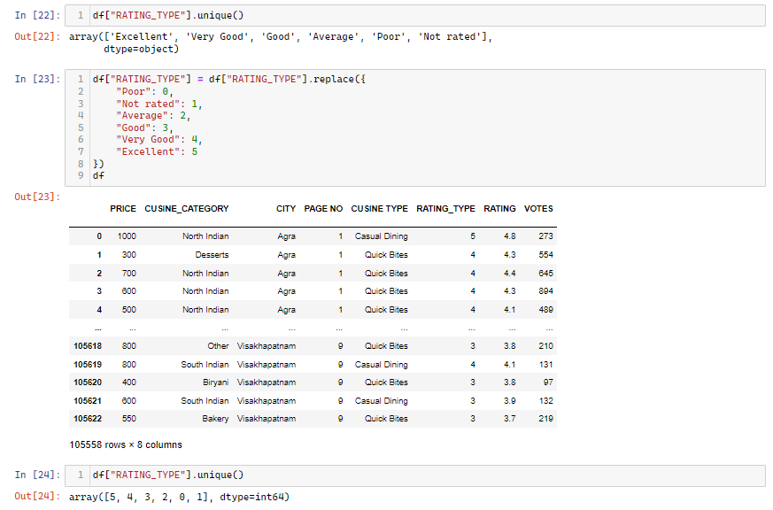
Data Cleaning

Slide 16
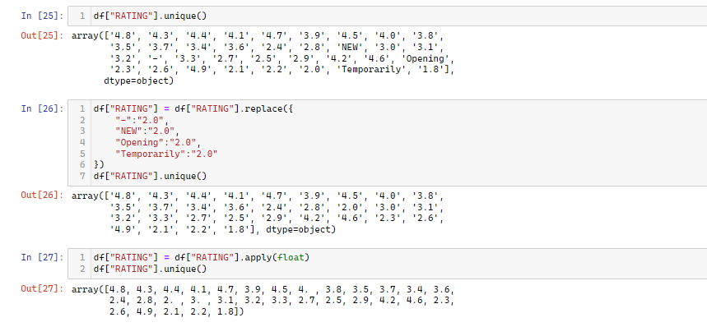
Data Cleaning

Slide 17
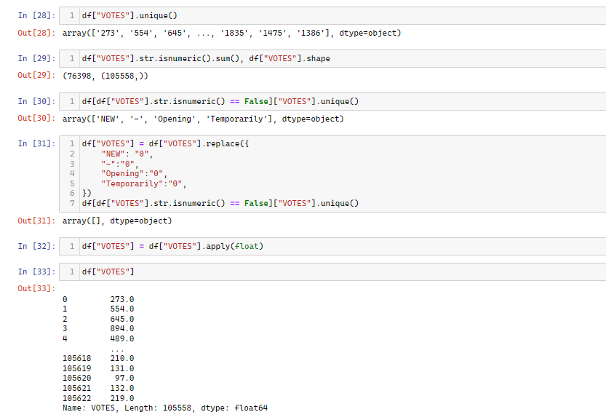
Data Cleaning

Slide 18
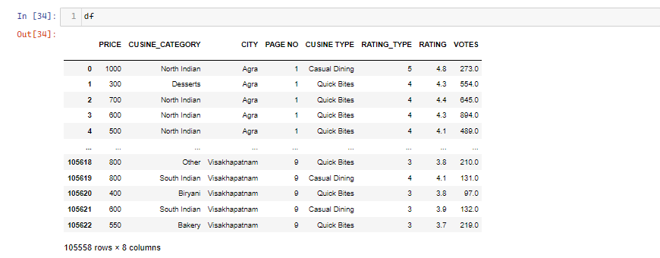
Data Cleaning

Slide 19
Outlier Removal

Slide 20
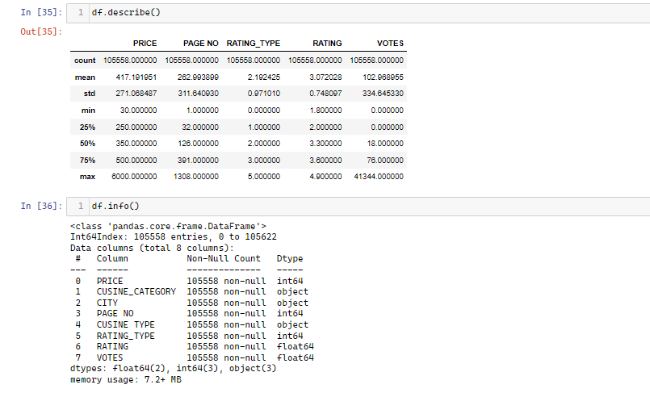
Outlier Removal

Slide 21
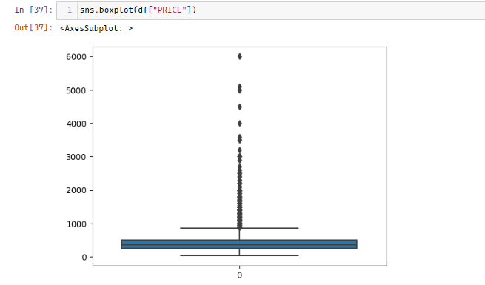
Outlier Removal

Slide 22
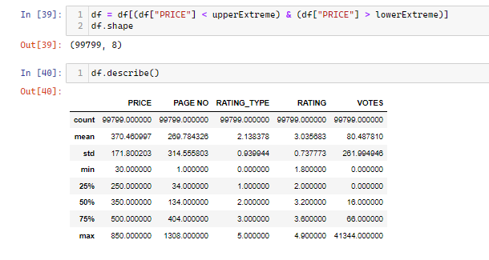
Outlier Removal

Slide 23
Data Analysis and Insights

Slide 24
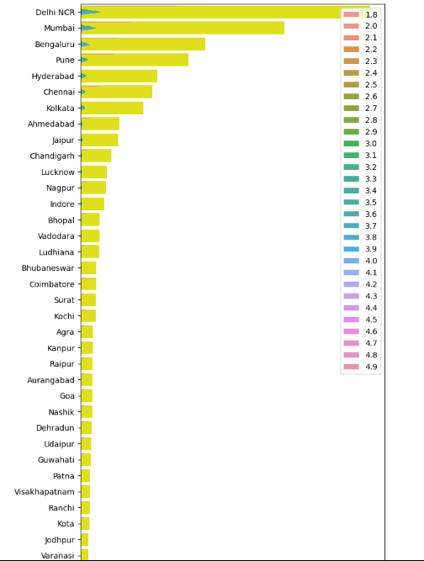

Data Analysis and Insights
Insights:
The most amount of resturants associated with zomato are in Delhi NCR, Mumbai and Bengaluru
There are very less amount of highly rated resturants associated with zomato in popular cities like Kanpur, Goa, Agra, Bhopal. So, these cities may be ideal for opening a resturant and getting associated with zomato

Slide 25
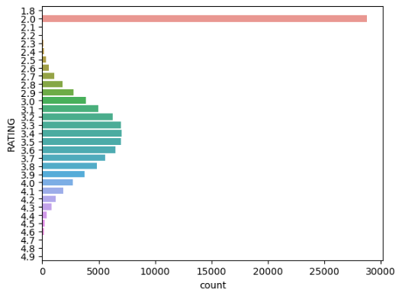
Data Analysis and Insights
Insights:
Most of the restaurants are either not rated or have ratings less than 2.5
The ratings are normally distributed
The average rating of a restaurant is around 3.5

Slide 26
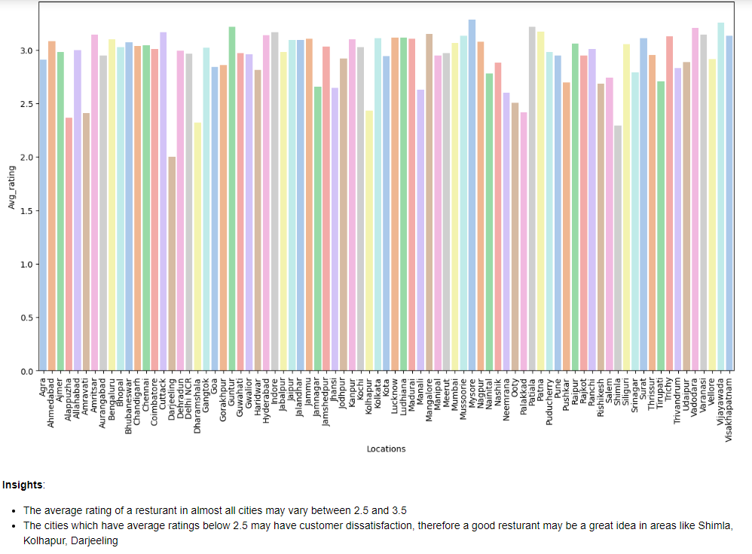
Data Analysis and Insights

Slide 27
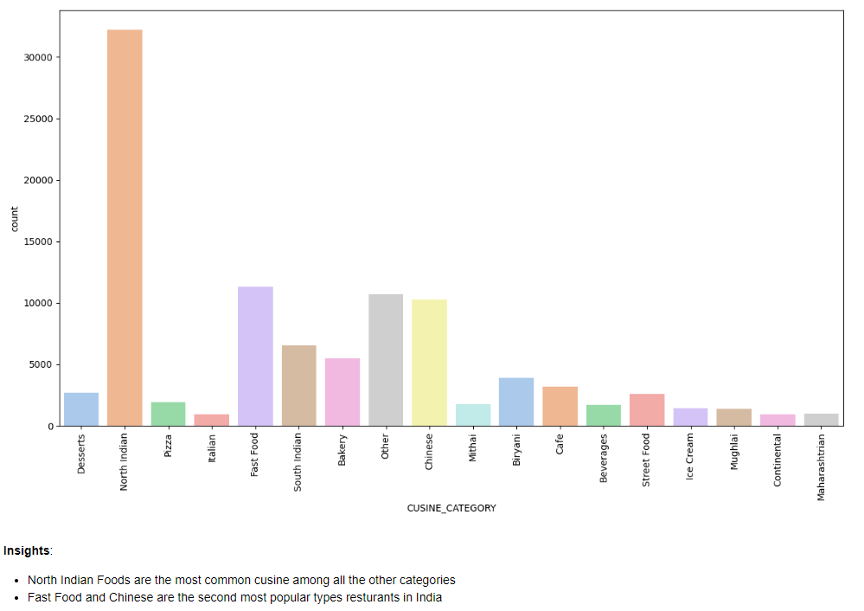
Data Analysis and Insights

Slide 28
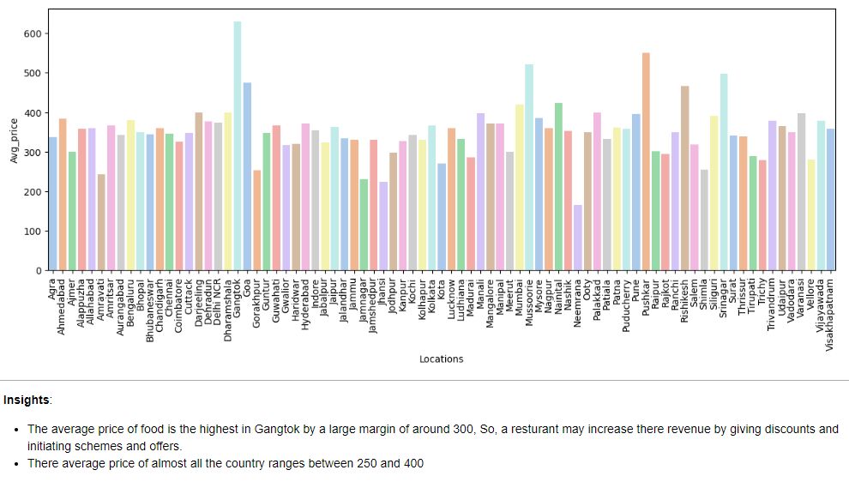
Data Analysis and Insights

Slide 29
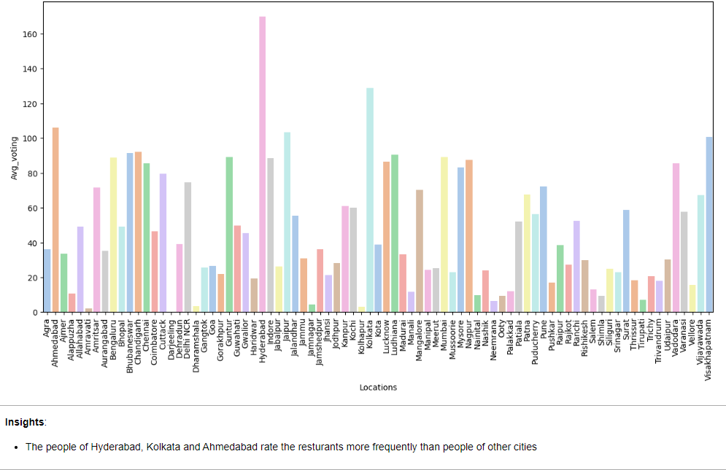
Data Analysis and Insights

Slide 30
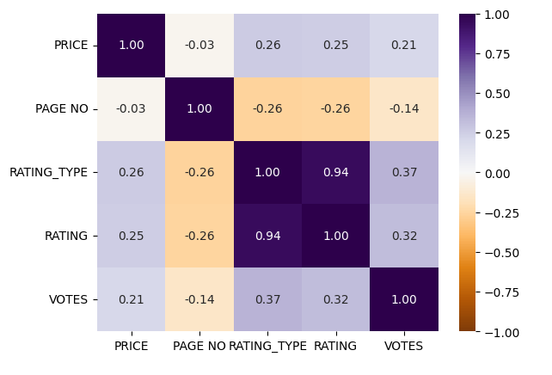
Data Analysis and Insights
Insights:
There is a very good relation betwen rating and rating_type
Page number is has a negative correlation with rating, which means that as the page no. increases the rating of the resturant decreases

Slide 31
Data Splitting

Slide 32
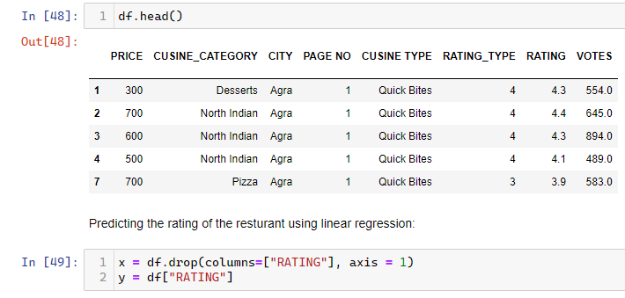
Data Splitting

Slide 33
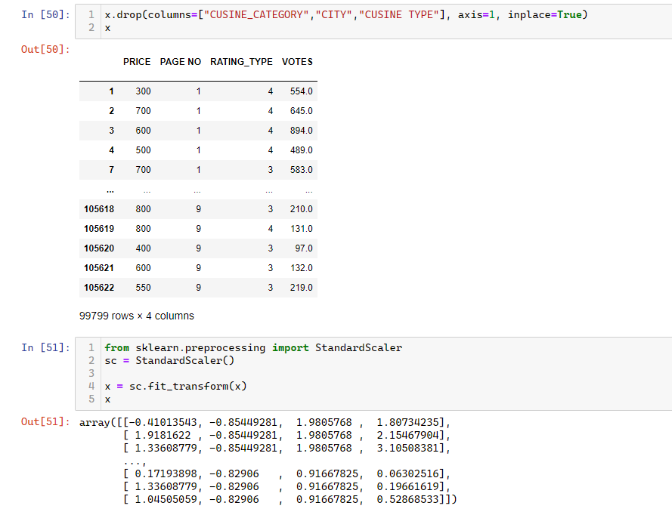
Data Splitting

Slide 34
Data Splitting

Slide 35
Modeling

Slide 36
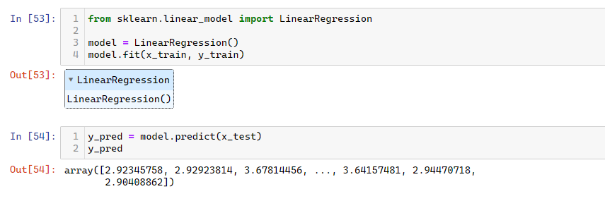
Modeling

Slide 37
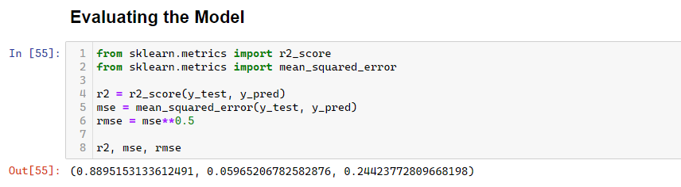
Modeling

Slide 38
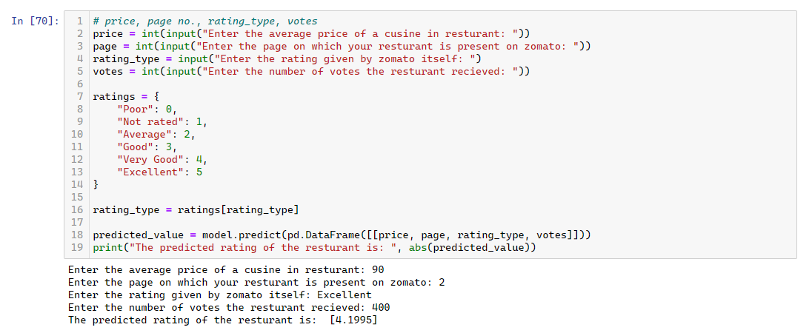
Prediction System

Slide 39
Thank You

